Slide 1

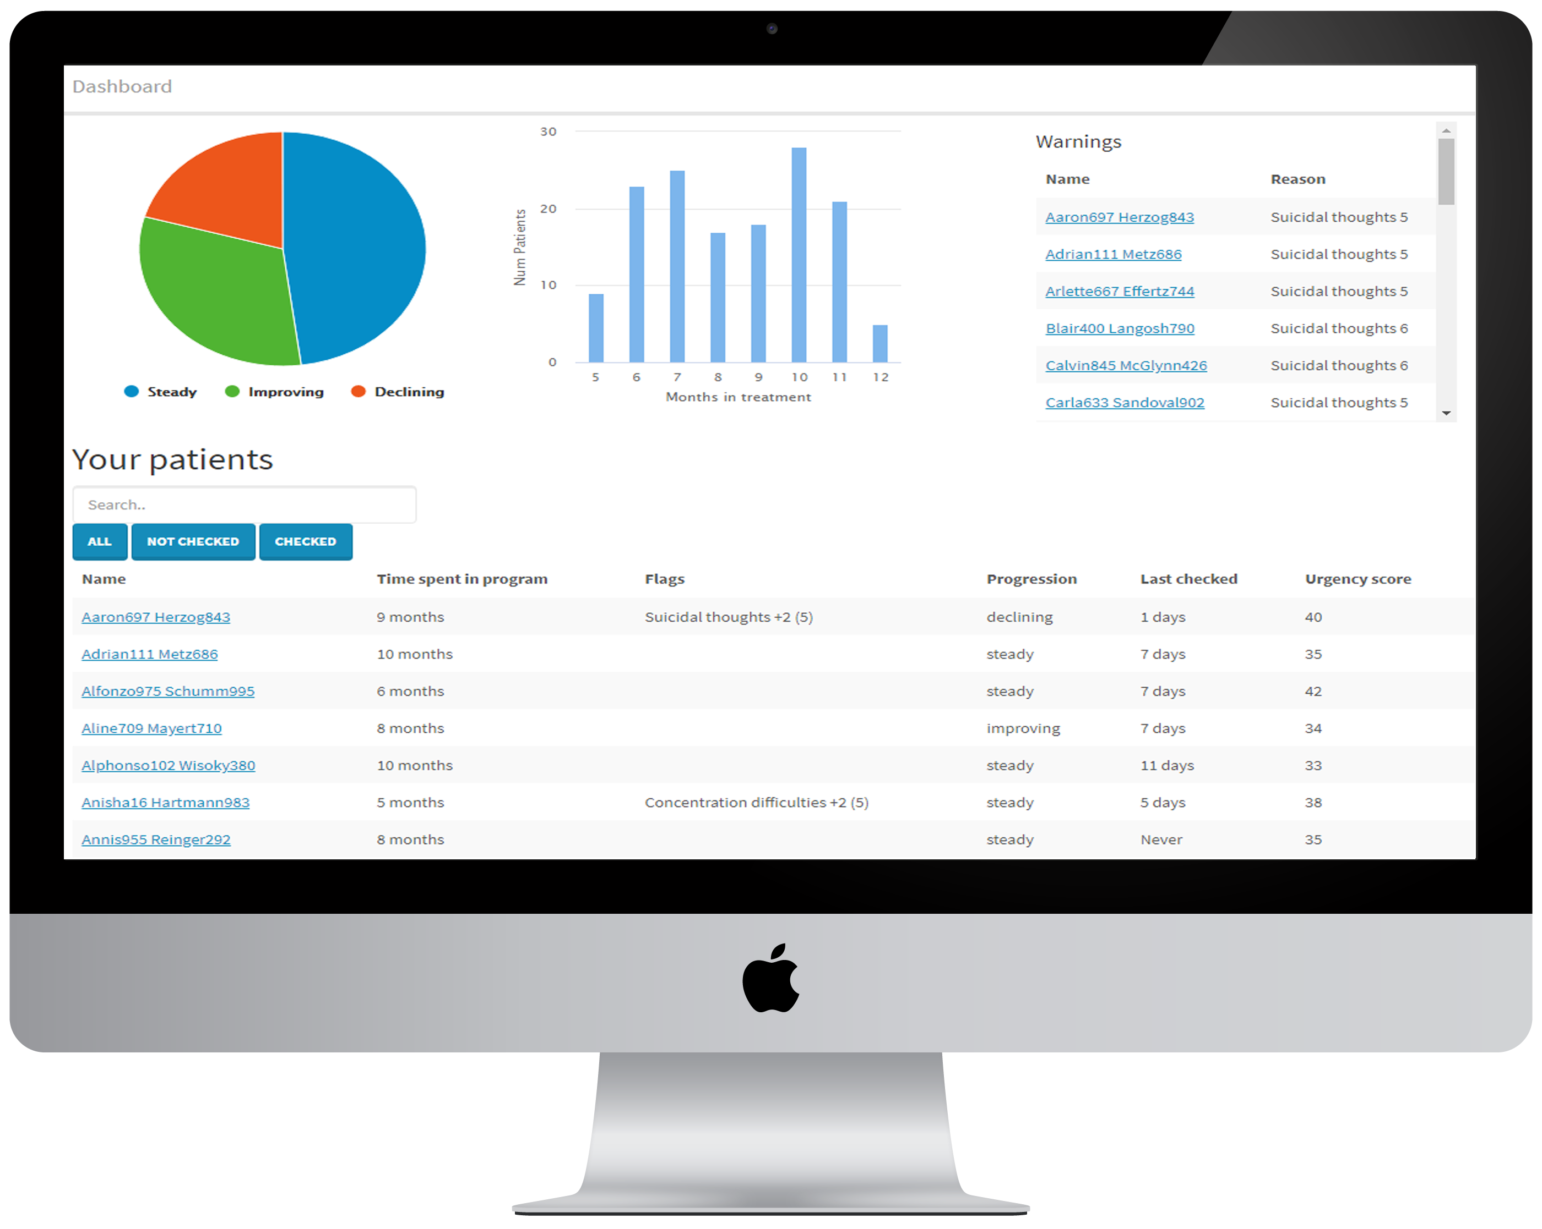




Infographic title
Mental Health & AI
An architecture for creating self-reporting e-health systems
Suresh Kumar Mukhiya¹, Fazle Rabbi¹, Violet Ka I Pun^{1,2}, Yngva Lamo¹
¹ Western Norway University of Applied Sciences, ²University of Oslo
Web Client
Data Lake
Therapists’ dashboard to visualize patient’s information and monitor their progress
Interface to create Internet Delivered Therapies like Cognitive Based Therapy.
Resource Server
Application Platform
Research ToolBox
Data Processing
Data Analytics
Recommendatiion Engine
Big data Analysis
Process Mining
ID-porten
HelseID
OpenID Connect, OAuth2.0
BankID, Buypass
Authorization Server
Mobile Client
Collects biological markers using sensors
Provides CBT interface
Conversational Agents interface
Sensor devices connects to mobile-client using standard Bluetooth protocol.
Healthcare Provider Clients
Other National Resources
External Tools and Applications
Regional clinical core systems
Middleware
Legacy System
Problem Domain
Architecture Presented
Why?
Results and Discussion
Increase in mental health problems creates socio-economic challenges for patients, society, and relatives [1]. We address:
Heterogenity of information across various healthcare service providers
Lack of Internet Delivered treatment available and accessible to patients and healthcare providers
Lack of adaptiveness in patient-centered care
This project mainly focuses on Depression, ADHD, Social Anxiety Disorder, Bipolar Disorder and Psycho-social support for women recovering from gynecological cancer
We envision building an adaptive system:
Based on SOA principles the INTROMAT Core architecture for self-assessment and evaluation of mental or neurological disorder
HL7 FHIR [2] standard to support interoperability for Health Information Exchange; it incorporates standard terminologies such as SNOMED-CT, LOINC, ICD-10 etc.
Why modular architecture? The presentation provides a high level overview of the project. To support an iterative development of the platform, we focus on developing solution components that are modular and composable. This allows the restructuring of the solution without the need for extensive rework. This architecture principle permits us to adapt the solution as we move on.
The solution will be used by several stakeholders including:
Patients: Self—reporting mobile apps to manage their mental health
Therapist: Web-based backend for visualization and managmenet of therapies and patients information
Researchers: Aggregated patient data useful for research and for further analysis
Industrial Partners: The proposed prototype with APIs can be extended to create healthcare services for mental health patients
Partners
References
Suresh Kumar Mukhiya, Fazle Rabbi, K. I. P. Y. L. An architectural design forself-reporting e-health systems. In ICSE 2019 Proceedings in the IEEE Digital Library (2018)
Hl7 FHIR SMART app launch, Retrieved December 28, http://hl7.org/ fhir/smart-app-launch/.
www.intromat.no
skmu@hvl.no
94430044

